Slide 1
Narrative Remix Assignments in the Digital Writing Classroom
Traci Gardner
@tengrrl

Slide 2
Presentation online at
www.tengrrl.com/cwcon/2015/
(all lowercase)

Slide 3
Defining Multimodal Texts
Visual | images and things like color, layout, style, size
Aural | sound
Gestural | movement, facial expression, gestures
Spatial | physical arrangement (in space)
Linguistic | written or spoken words

Slide 4
Overarching Remix Assignment
Take an existing story (fiction or nonfiction) told primarily in the linguistic mode and translate it into a new, digital, multimodal version.
Make it a passion project.
Set a goal that involves risk.
3844s15.tracigardner.com/assignments/project-4-remix-a-story/

Slide 5
Overarching Remix Assignment
Step 1. Choose a story.
Step 2. Choose a form for your story.
Step 3. Pitch your project.
Step 4. Develop and refine your project.
Step 5. Present your project.

Slide 6
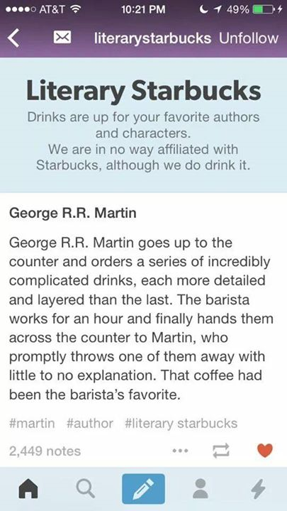
1. Literary Starbucks
literarystarbucks.tumblr.com

Slide 7
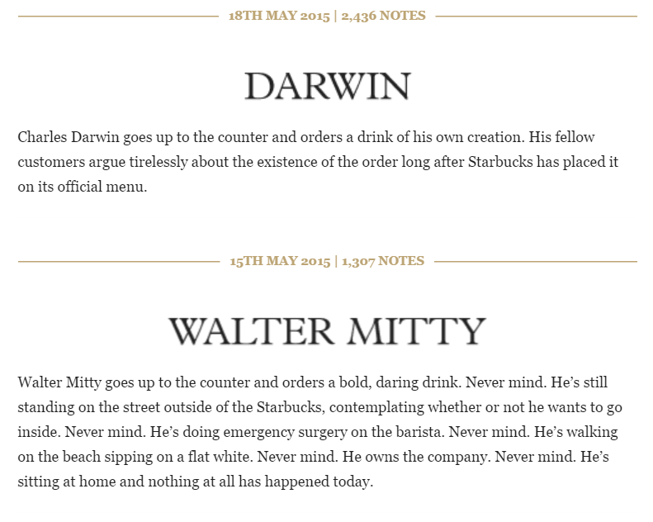
Literary Starbucks
literarystarbucks.tumblr.com

Slide 8
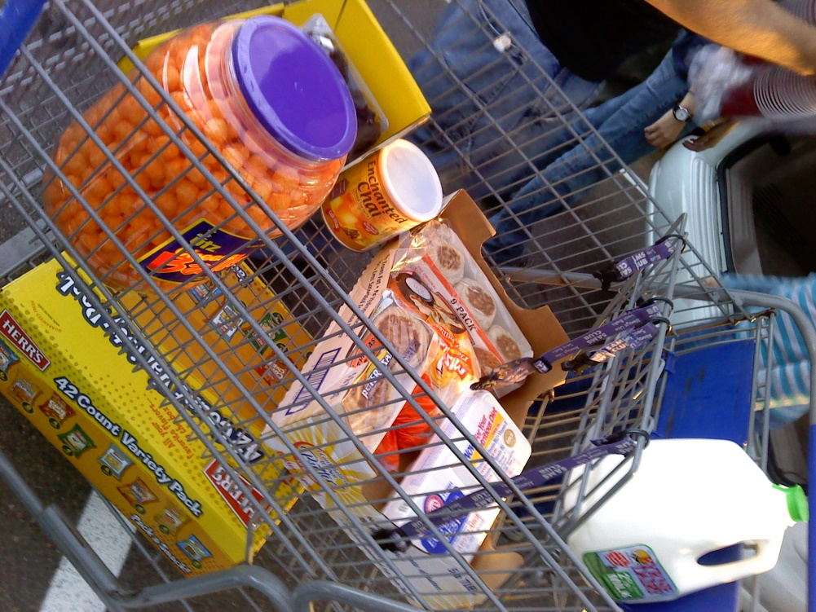
Based on Literary Starbucks
Shopping cart contents. What would authors or characters have in their basket? What line would they choose? How would they place their goods on the conveyor belt?
From http://blogs.bedfordstmartins.com/bits/assignment-idea-2/a-list-of-ten-inspired-by-literary-starbucks/tgardner/
Photo: Day 261: Shopping Haul by crimsong19, on Flickr

Slide 9
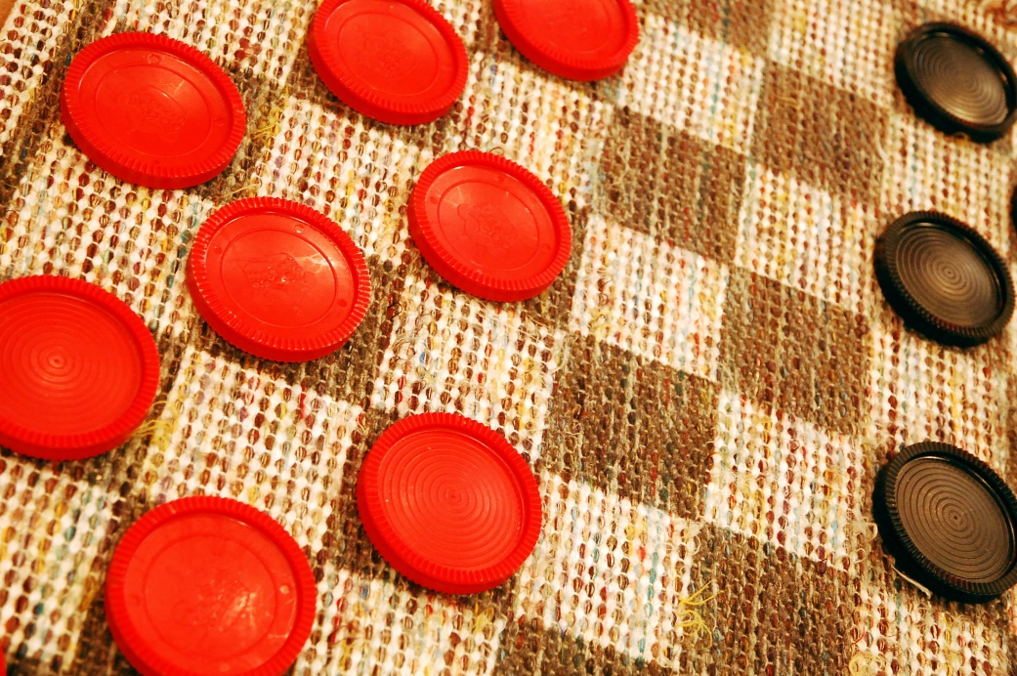
Based on Literary Starbucks
Loser’s reaction. The author or character just lost a game (choose a specific game—anything from checkers to Call of Duty). What happens next?
From http://blogs.bedfordstmartins.com/bits/assignment-idea-2/a-list-of-ten-inspired-by-literary-starbucks/tgardner/
Photo: Checkers by Steve Snodgrass, on Flickr

Slide 10
2. Based on Pinterest
An author might collect while writing
A character might use while planning en event
A character/historical figure’s hobby
First-person witness to historical event
From http://3844s15.tracigardner.com/assignments/project-4-remix-a-story/pinterest-board-ideas/
See also http://blogs.bedfordstmartins.com/bits/authors-2/traci-gardner/ten-pinterest-assignments/tgardner/ and
http://blogs.bedfordstmartins.com/bits/authors-2/traci-gardner/pinterest-logistics/tgardner/

Slide 11
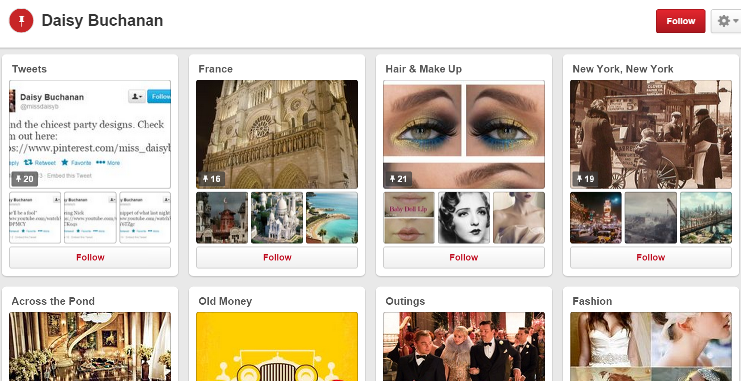
Student Project
From https://www.pinterest.com/miss_daisyb/

Slide 12
3. Based on PostSecret
Postcards
from a character
from a political or historical figure
from a group of characters on a related topic
from a group of witnesses to the same event

Slide 13
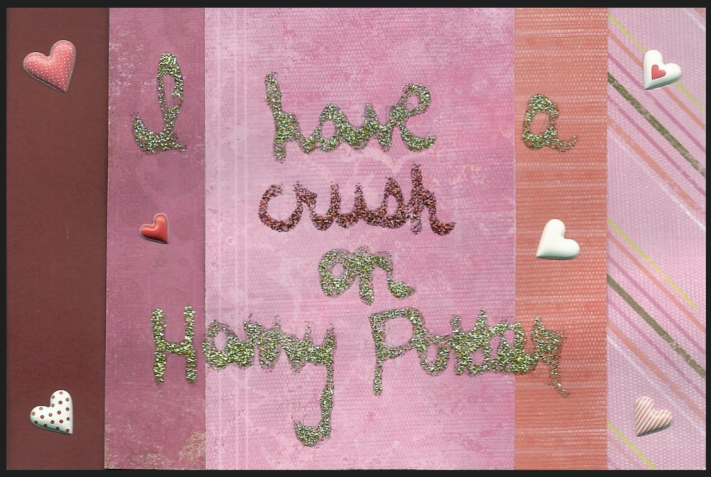
Student Project
From https://chamberofpostsecrets.wordpress.com/

Slide 14
Student Project
From https://chamberofpostsecrets.wordpress.com/

Slide 15
4. Mash-up of Social Media
Track the development of a story or event using evidence collected from social media.
Work off the ways that news stories piece together photos and quotations from Twitter, Instagram, and YouTube.

Slide 16
Student Projects
From https://prezi.com/s3yjcfo1m95p/what-happened-to-little-red-riding-hood/

Slide 17
Student Projects
From https://prezi.com/s3yjcfo1m95p/what-happened-to-little-red-riding-hood/

Slide 18
5. Create Artifacts for the Story
Build a collection of digital artifacts found on a character’s USB drive (e.g., letters, “to do” lists, data, and poems written by the character for his or her eyes only)

Slide 19
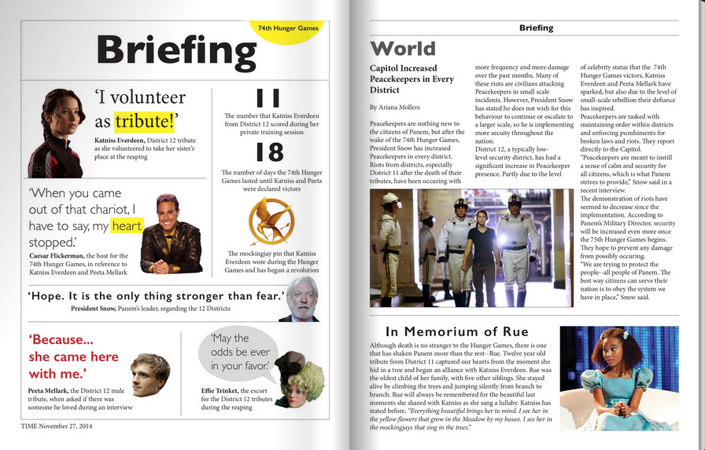
Student Projects
From http://fliphtml5.com/eqpj/hwaj

Slide 20
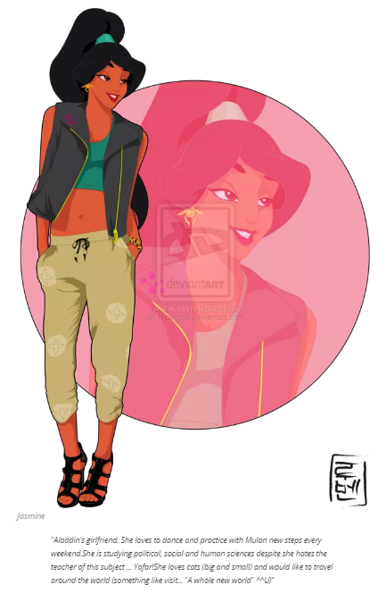
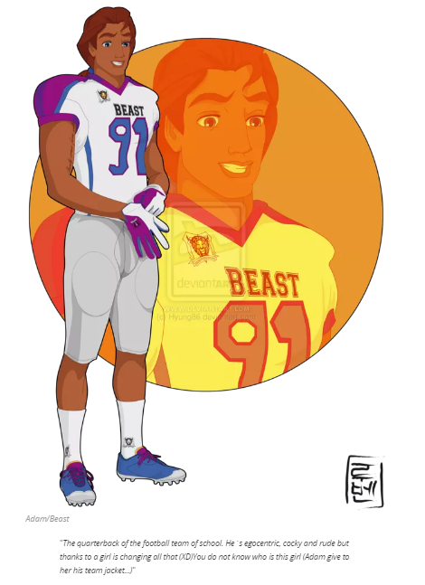
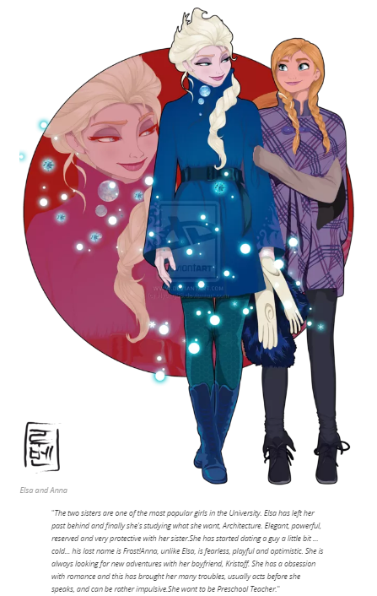
6. Combine Stories in a New Context
From http://moviepilot.com/posts/2014/06/04/disney-characters-go-to-college-1470600?lt_source=external,manual

Slide 21
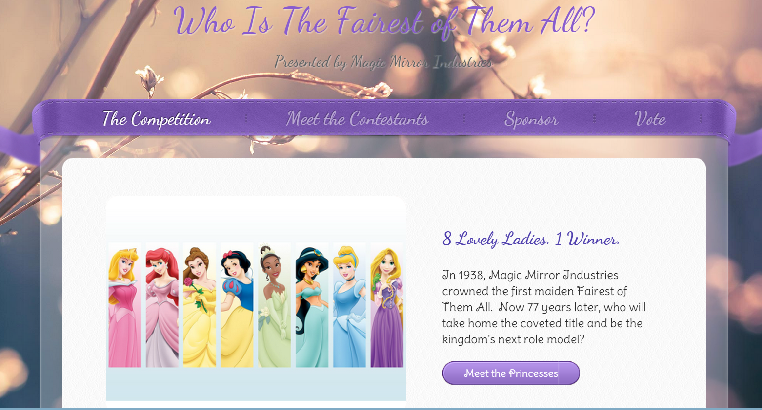
Student Project
From http://whoisthefairestofthemall.weebly.com/

Slide 22
Student Project
From http://whoisthefairestofthemall.weebly.com/

Slide 23
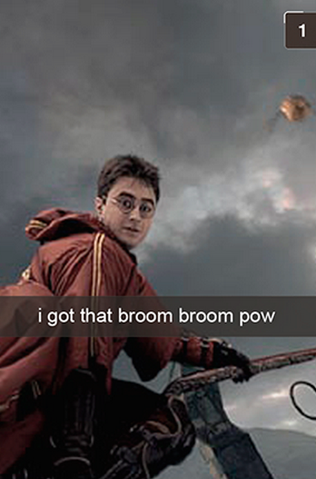
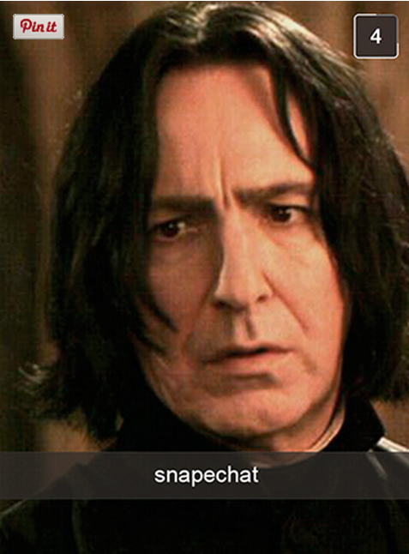
7. Based on SnapChat Mashups
From http://www.buzzfeed.com/jarrylee/snapechat#3nf1l5o
See also http://blogs.bedfordstmartins.com/bits/authors-2/traci-gardner/snapchat-mashups/tgardner/

Slide 24
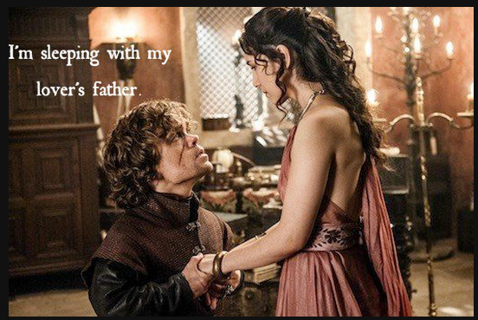
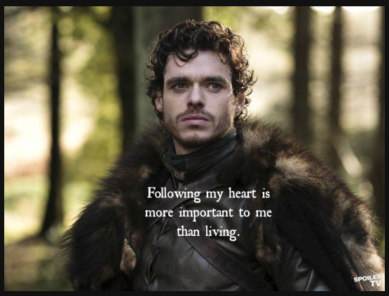
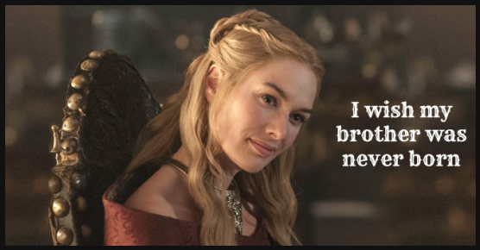
Student Project
From http://whoisthefairestofthemall.weebly.com/

Slide 25
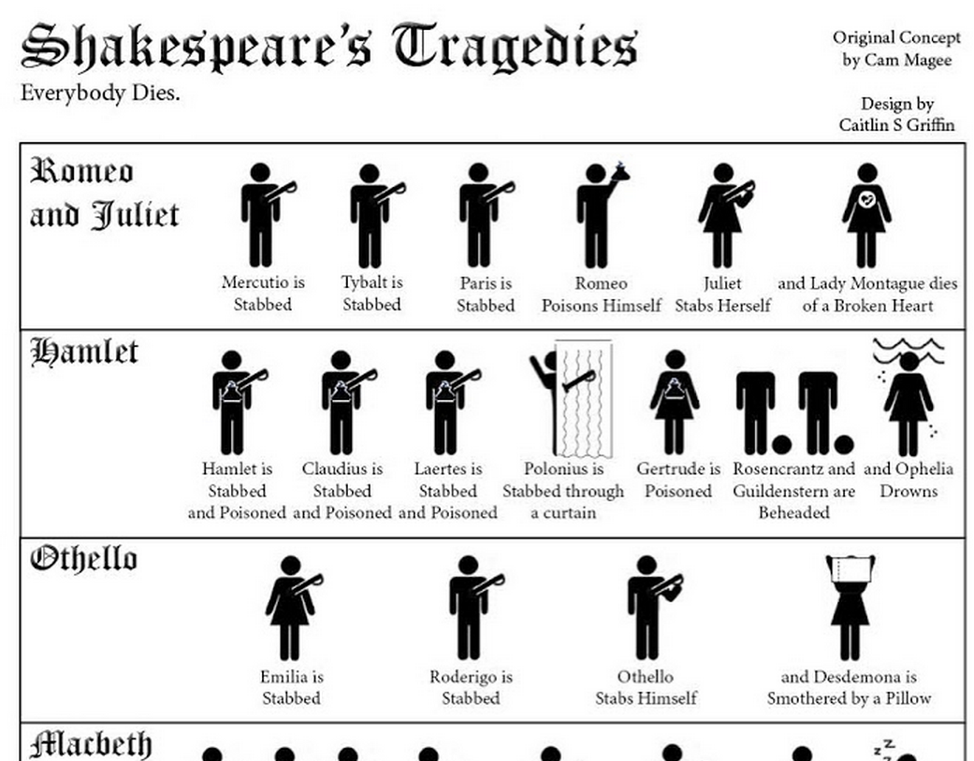
8. Create a Related Infographic
From http://degreesearch.org/blog/wp-content/uploads/2013/03/shakespeares-tragedies-infographic-.jpg

Slide 26
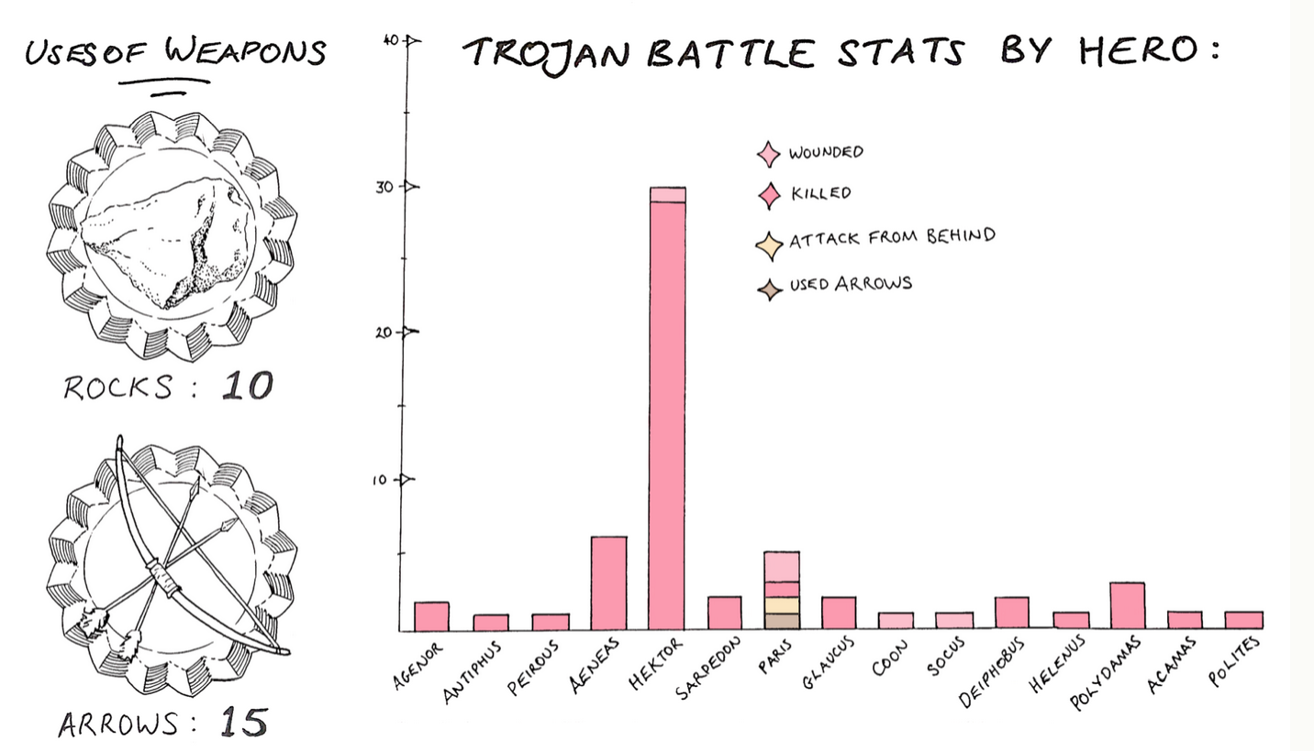
Example Project
From https://greekmythcomix.wordpress.com/comic/deaths-in-the-iliad-a-classics-infographic/

Slide 27
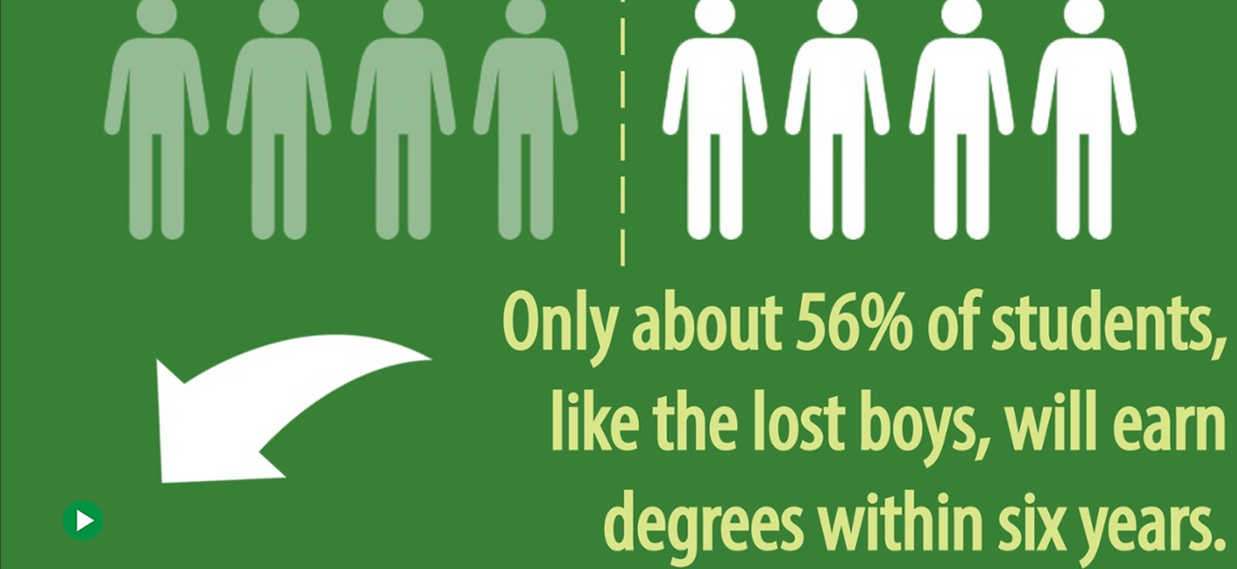
Student Project
From http://www.thinglink.com/scene/591999152297082881

Slide 28
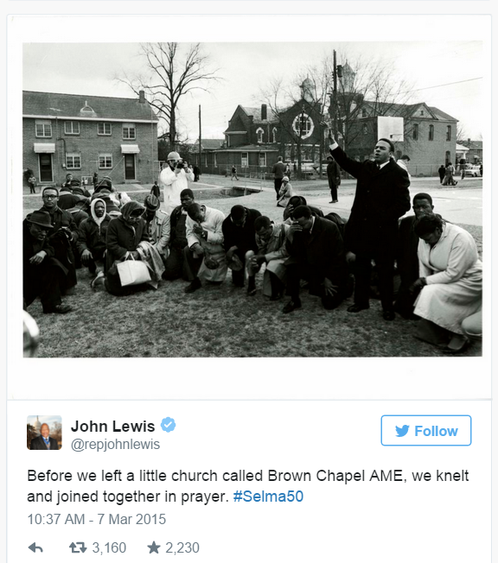
9. Live Blog/Updates on an Event
From http://www.mediaite.com/online/rep-john-lewis-tweets-dramatic-recounting-of-selma-march/
Notes:
“live” blogging/reporting of an event from the story by a character/participant (Rep. John Lewis Tweets Dramatic Recounting of Selma March)

Slide 29
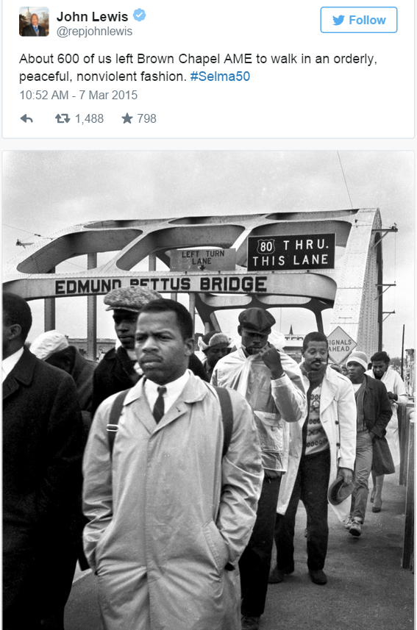
9. Live Blog/Updates on an Event
From http://www.mediaite.com/online/rep-john-lewis-tweets-dramatic-recounting-of-selma-march/
Notes:
“live” blogging/reporting of an event from the story by a character/participant (Rep. John Lewis Tweets Dramatic Recounting of Selma March)

Slide 30
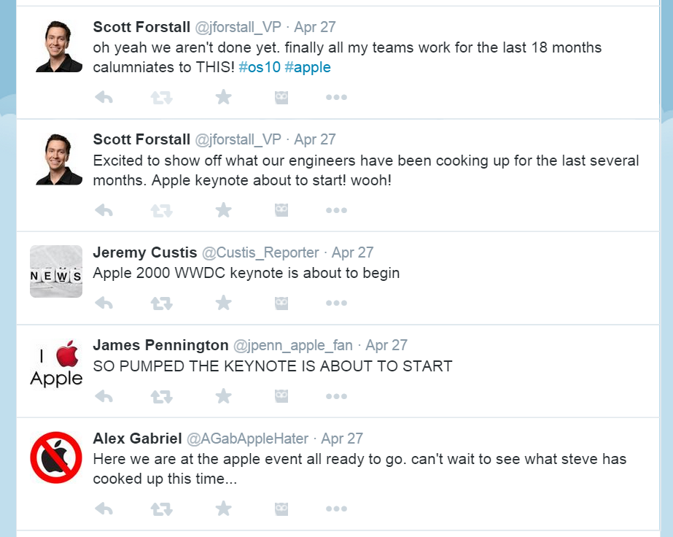
Student Project

Slide 31
10. Retell the Story in a New Format
Tell the story through
Twitter updates and retweets
Instagram photos
Facebook updates

Slide 32
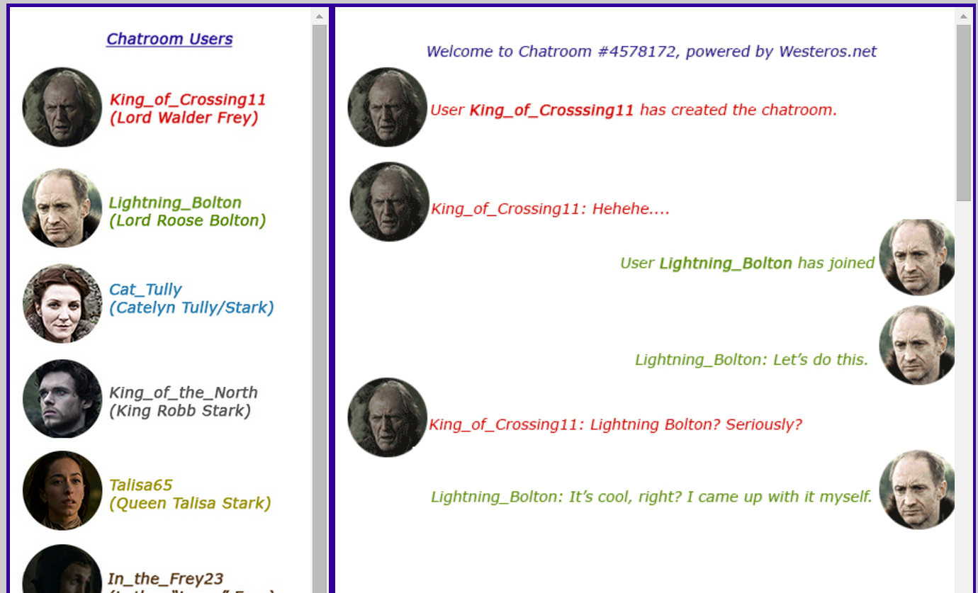
Student Project
From http://www.westerosnet.jaylaiche.com/#

Slide 33
Student Mockup

Slide 34
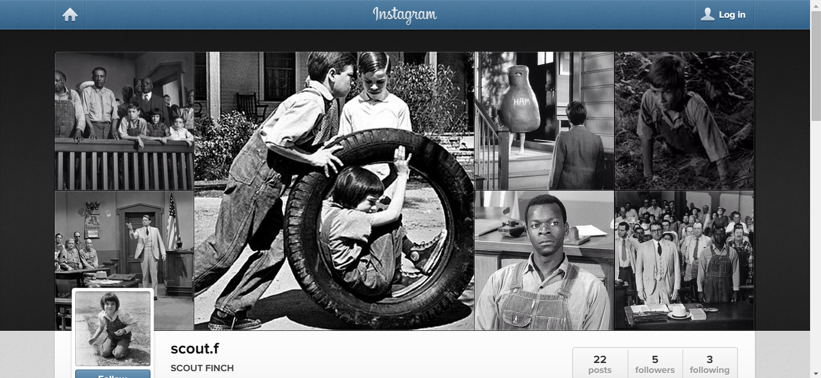
Student Project
From https://instagram.com/scout.f/

Slide 35
Presentation online at
www.tengrrl.com/cwcon/2015/
(all lowercase)

